Slide 1
Generate given output
- presented by
Group 6
FYCM

Slide 2

C LANGUAGE
C was originally developed at Bell Labs by Dennis Ritchie between 1972 and 1973 to make utilities running on Unix.
During the 1980s, C gradually gained popularity. It has become one of the most widely used programming languages.

Slide 3
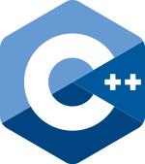
C++
C++ is a high-level, general-purpose programming language created by Bjarne Stroustrup as an extension of the C programming language, or "C with Classes".
The language has expanded significantly over time, and modern C++ has object-oriented, generic, and functional features in addition to facilities for low-level memory manipulation.

Slide 4
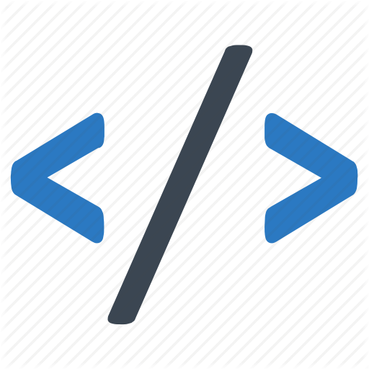
Loops in C
Looping is one of the key concepts on any programming language.
It executes a block of statements number of times until the condition becomes false.
Loops are of 2 types: entry-controlled and exit-controlled.

Slide 5
Types of Loop
For
While
Do – While

Slide 6
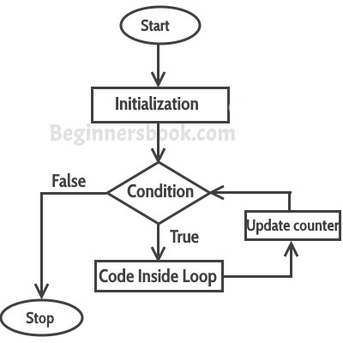
For Loop
In computer science, a for-loop is a control flow statement for specifying iteration, which allows code to be executed repeatedly.
For-loops are typically used when the number of iterations is known before entering the loop.

Slide 7
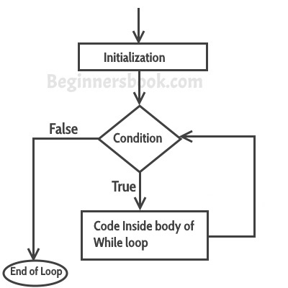
While Loop
C while loops statement allows to repeatedly run the same block of code until a condition is met.
While loop has one control condition, and executes as long the condition is true.

Slide 8
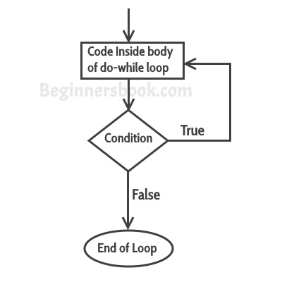
Do - While
A do while loop is similar to while loop with one exception that it executes the statements inside the body of do-while before checking the condition.
if a condition is false at the first place then the do while would run once, however the while loop would not run at all.

Slide 9
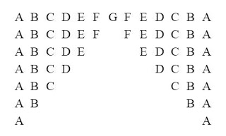
AIM
To generate the following output:

Slide 10
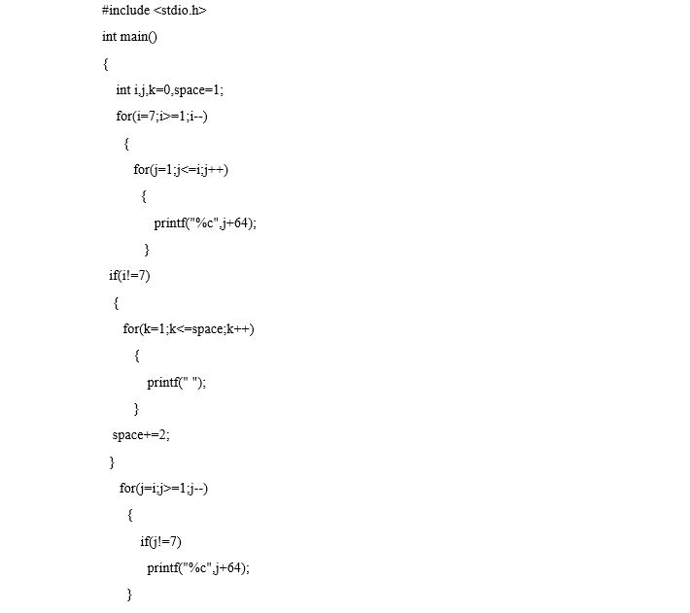
Source Code
The code required to generate the output is as follows:

Slide 11
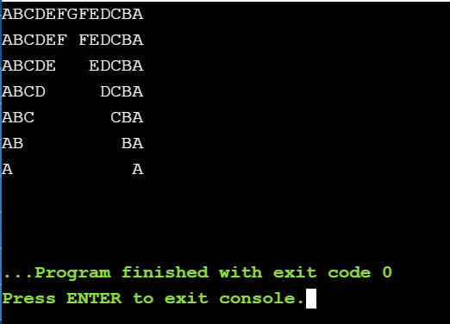
Output

Slide 12
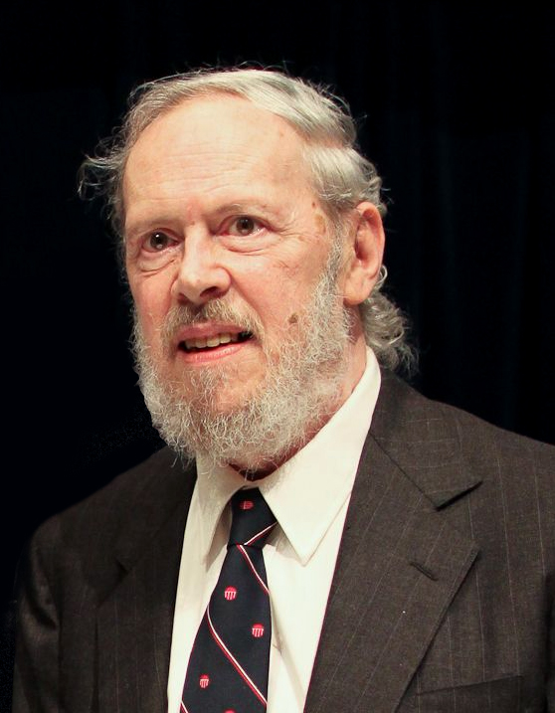
Analysis
C language was created by Dennis Ritchie. C language has a great aspect in its own field. It has various syntaxes and its own special structure, which makes it a unique. With use of different loops and statements the following output is created as requested.

Slide 13
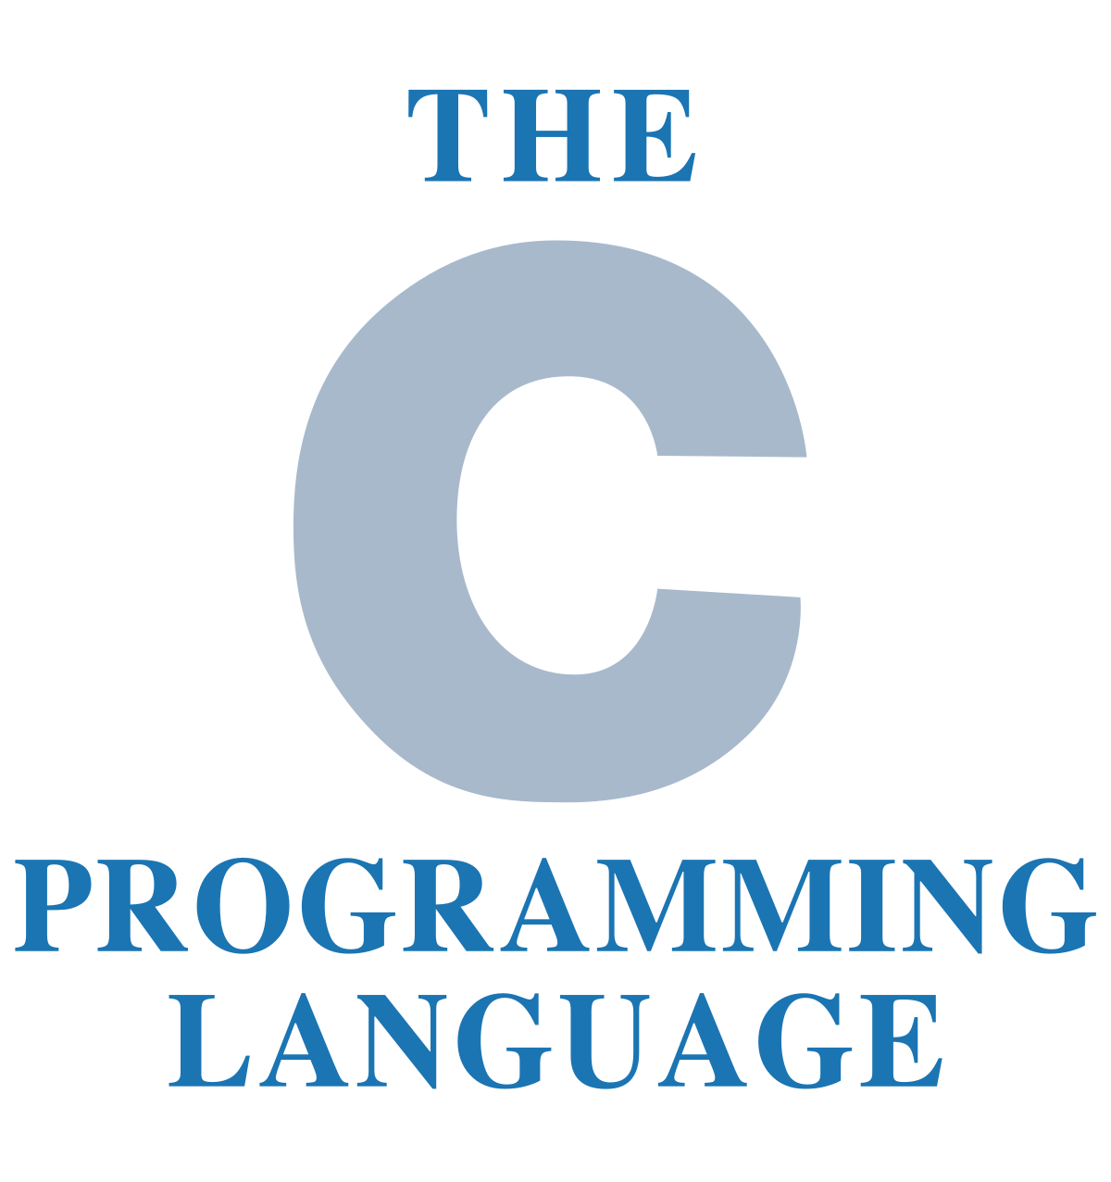
Conclusion
C is a procedural programming language that was designed by American computer scientist Dennis Ritchie.
The language - which first appeared in 1972 - was developed by Ritchie in association with Bell Labs.
Despite being close to 50 years old, the C programming language has not lost its relevance in the modern day computer software development scene.

Slide 14
Thank you!

